Slide 1
Object Oriented Programming
Les 5: Strings, geavanceerde zaken
(Engelstalige slides)

Slide 2
Strings
Arrays of chars are:

Slide 3
Strings: What are they?
What is a string?
In real-life: A sequence of letters and numbers
In C#: A collection of char data types (0, 1, n)

Slide 4
Strings: What are they?
Where area strings used?
Everywhere!
Probably the most commonly used type
All inputs in .NET Console, Web, Windows applications are initially strings

Slide 5
Verbatim & Escape Characters
Escape Characters are non-printable characters
Data read from files may contain these characters
Data written to files may contain these characters
Verbatim Character: @
Means “as-is”, literally
Adding the verbatim character eliminates the effects of “\”
Often used in local file paths

Slide 6
Escape characters
C# defines the following character escape sequences:
\' – single quote, needed for character literals
\" – double quote, needed for string literals
\\ – backslash
\0 – Unicode character 0
\a – Alert (character 7)
\b – Backspace (character 8)
\f – Form feed (character 12)
\n – New line (character 10)
\r – Carriage return (character 13)
\t – Horizontal tab (character 9)
\v – Vertical quote (character 11)
\uxxxx – Unicode escape sequence for character with hex value xxxx
\xn[n][n][n] – Unicode escape sequence for character with hex value nnnn (variable length version of \uxxxx)
\Uxxxxxxxx – Unicode escape sequence for character with hex value xxxxxxxx (for generating surrogates)

Slide 7
Verbatim string literals: @ -character
Normally have to use escape characters
Verbatim string literals using the @ character
Most escape sequences ignored
Except for “”
Verbatim literals can be multi-line
string s1= “\\\\server\\fileshare\\filename.cs”;
string s2 = @“\\server\fileshare\filename.cs”;

Slide 8
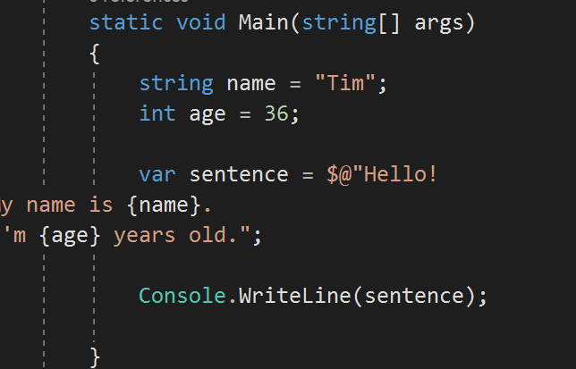
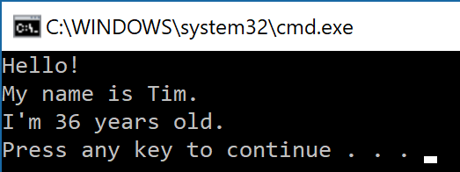
How about @ and $ together?
Not a problem!

Slide 9
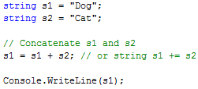
Concatenation
Concatenation:
Process of joining many strings together

Slide 10
Working with Delimited String
Use the Split() method of the string object to split delimited data
Parameter is the char that represents the delimiter
Returns an array of strings
Use String.Join() to join an array of strings
1st parameter is the delimiter to use
2nd parameter is the string array to join

Slide 11
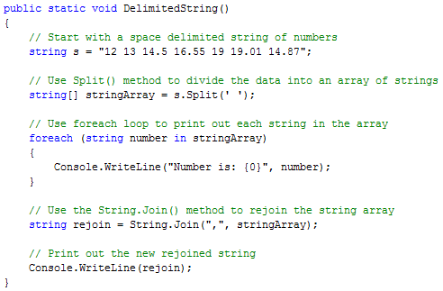
Working with Delimited String
Use the Split() method of the string object to split delimited data
Parameter is the char that represents the delimiter
Returns an array of strings
Use String.Join() to join an array of strings
1st parameter is the delimiter to use
2nd parameter is the string array to join

Slide 12
Length, Trim, …
Length
Number of characters in a string
A Property not method… notice no ()
IndexOf()
Returns an int representing the index of first character of the search string
Parameter is the string to search for
Trim()
Removes white spaces from a string
ToUpper()
Returns an UPPERCASE version of the string
ToLower()
Returns a lowercase version of the string

Slide 13
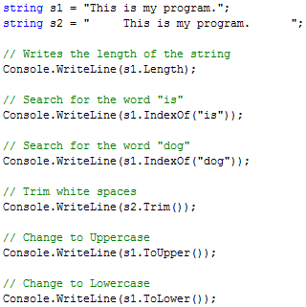
Exercise: what will be the output?

Slide 14
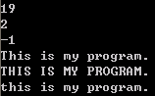
Length, Trim, …

Slide 15
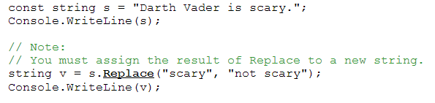
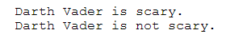
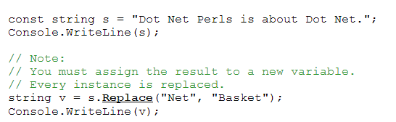
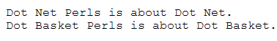
Methods
string Replace( string old, string new )

Slide 16
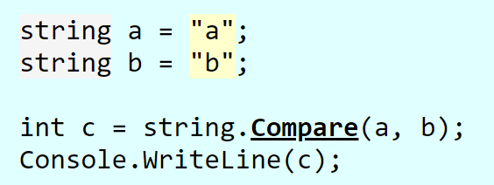
Methods
int Compare( string s1, string s2 )
-1: s1 < s2
0 : s1 == s2
1 : s1 > s2
returns an integer that indicates their relative position in the sort order

Slide 17
ReadAllLines
System.File.ReadAllLines
Return an arrays of strings, each string being one line of text (ending with \r\n) in the file
File.WriteAllLines : reverse, write string array to a file
Example:
string[] lines = File.ReadAllLines(@"c:\mymovies.csv");
for (int i = 0; i < lines.Length; i++)
{
Console.WriteLine(lines[i]);
}

Slide 18
A csv-parser example
Imagine you have a csv file such as soccerstars.csv containing the following text:
Dams;Tim;1981
Hamdaoui;Mounir;1984
Stoffels;José;1950
Following code parses the file, and prints the individuel information for each player:
string[] lines = File.ReadAllLines(@"c:\soccerstars.csv");
for (int i = 0; i < lines.Length; i++)
{
string[] splitted = lines[i].Split(';');
Console.WriteLine($"Voornaam speler {i}= {splitted[1]}" );
Console.WriteLine($"Achternaam speler {i}= {splitted[0]}");
Console.WriteLine($"Geboortejaar speler {i}= {splitted[2]}");
}

Slide 19
Using webclient to process online csv
https://bit.ly/2tE4CB0
System.Net.WebClient wc = new System.Net.WebClient();
string csv = wc.DownloadString("https://bit.ly/2tE4CB0");
string[] splitted = csv.Split('\n');
for (int i = 1; i < splitted.Length; i++)
{
string[] lijnsplit = splitted[i].Split(',');
Console.WriteLine("Data 1="+lijnsplit[0]);
Console.WriteLine("Data 2=" + lijnsplit[1]);
}
First line is a header

Slide 20
Meer info
Slides gemaakt door
Tim Dams (ziescherp.be), AP Hogeschool opleidingen elektronica-ict en toegepaste informatica
Sommige slides gebaseerd of gekopieerd van slidedecks van:
Programmeren in C# door Douglas Bell en Mike Parr (vert. Kris Hermans)
Microsoft Visual C# 2015: An Introduction to Object-Oriented Programming door Joyce Farrell
E.a.
Slides mogen aangepast worden, op voorwaarde dat deze slide steeds achteraan de slidedeck staat.

